Slide 1
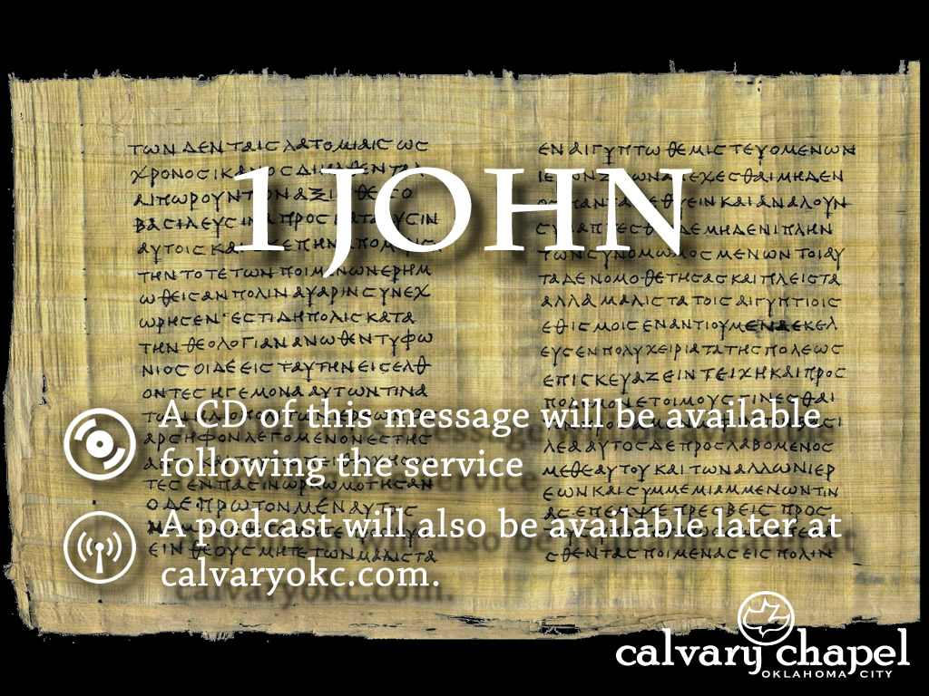
5:6-13

Slide 2
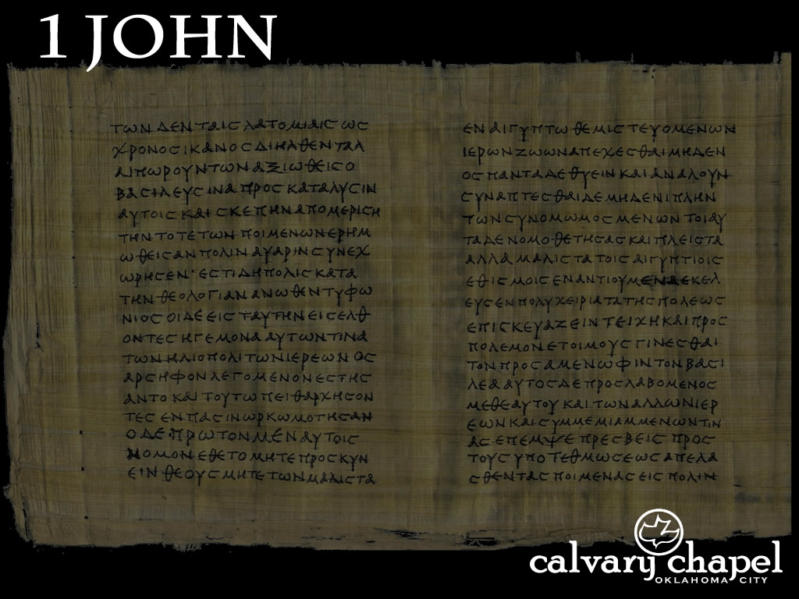
5:6-13
aptist
B
athroom
huch
C
ommode

Slide 3
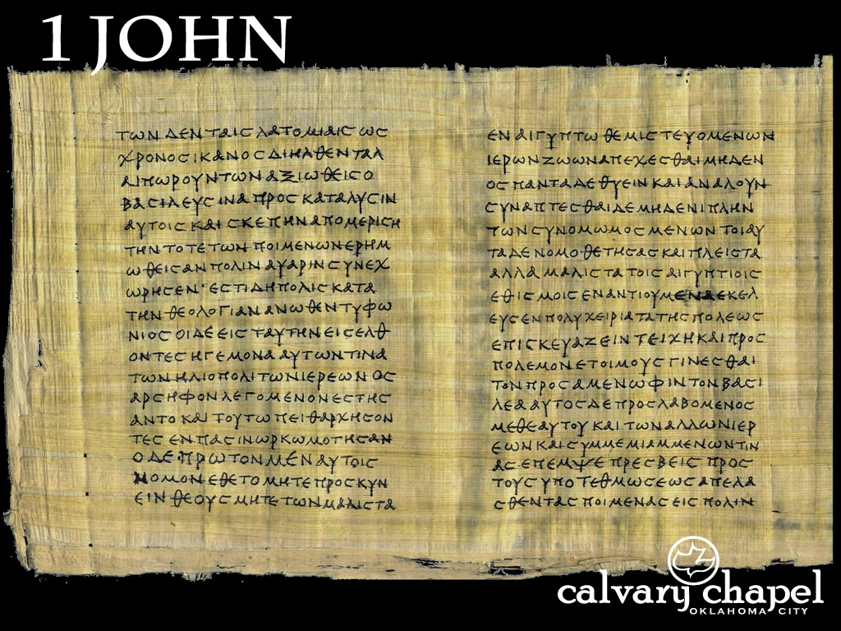
5:6-13

Slide 4


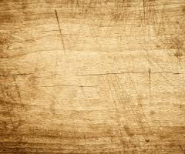
5:6-13
Water ~ baptism
Blood ~ crucifixion
Water
To
Wine
Cleanse
The
Lepers
Healed
The
Lame
Sight
To The
Blind
Raised
The
Dead
Sermon
On The
Mount
Fed
The
5000
Cast
Out
Demons
Forgave
Sin
Rose
From The
Dead
Α
Ω

Slide 5
5:6-13

Slide 6
5:6-13
NKJV ~ ⁷ For there are three that bear witness in heaven: the Father, the Word, and the Holy Spirit; and these three are one. ⁸ And there are three that bear witness on earth: the Spirit, the water, and the blood; and these three agree as one.
NASB ~ (A few late mss add … )
NLT ~ (A few very late manuscripts add … )
NIV ~ (Late manuscripts of the Vulgate … not found in any Greek manuscript before the sixteenth century)

Slide 7
5:6-13
“Johannine Comma”
Over 26,000 manuscripts (partial or complete)
Over 5,800 Greek
Desiderius Erasmus, 1516 ~ Textus Receptus (Received Text)
19th century rise in “eclecticism”
Not used by Justin Martyr, mid-2nd century or Irenaeus, c. AD 180
Earliest attestation: Cyprian, early 3rd century
A. T. Robertson: over 99.9% of the text and 100% of the truth

Slide 8
5:6-13

Slide 9
5:6-13
Eccl. 3:11 ~ He has made everything beautiful in its time. Also He has put eternity in their hearts, except that no one can find out the work that God does from beginning to end.

Slide 10
5:6-13
Here
Eternity

Slide 11
5:6-13

Slide 12
5:6-13
There are four reasons John gives us for writing this letter
1:4 ~ And these things we write to you that your joy may be full.
2:1 ~ My little children, these things I write to you, so that you may not sin.
2:26 ~ These things I have written to you concerning those who try to deceive you.
5:13 ~ These things I have written to you … that you may know that you have eternal life,

Slide 13
5:6-13

Slide 14
5:6-13
Zac Poonen ~ “When you are not sure of your salvation, it is very easy to get discouraged and to backslide.”
Believe in ~ eis - into

Slide 15
5:6-13

